Slide 1
Firm Connect
Asara Tenney

Slide 2
Lead Poisoning in Children
Lead paint and leaded pipes
Difficult to detect & causes latent developmental issues
damage to the brain and nervous system,
slowed growth and development,
learning and behavior problems (e.g., reduced IQ, ADHD, juvenile delinquency, and criminal behavior), and
hearing and speech problems. See CDC

Slide 3
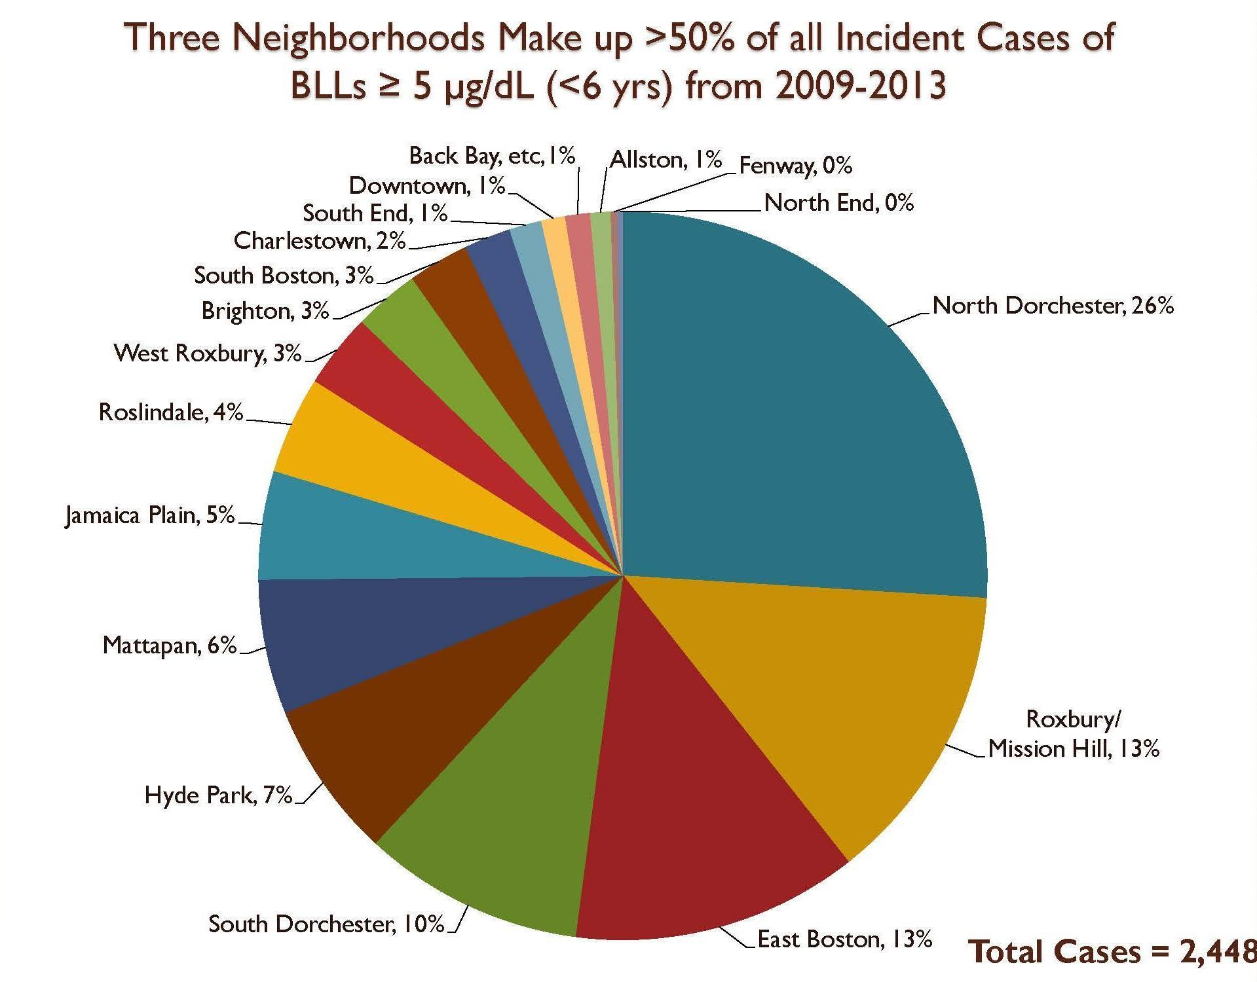
Disparate impact on minority communities

Slide 4
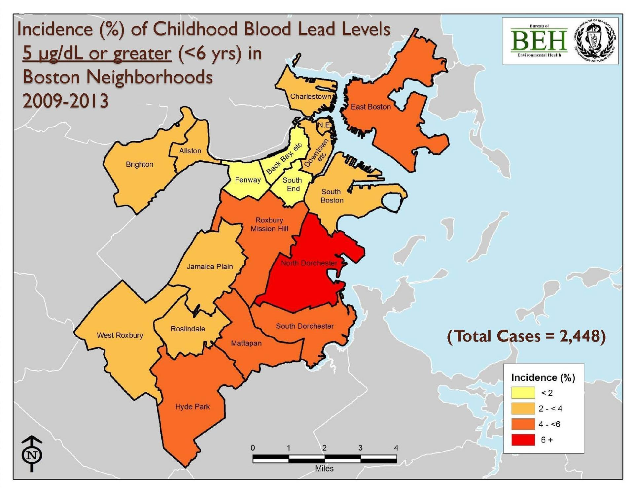

Slide 5
Lead Laws in Massachusetts
MGL 111 s. 189A-199B Lead Poisoning Prevention & Control MGL 111 s. 127B-1/2 Removal of Dangerous Levels of Lead Paint MGL 93A s. 2, 9, 11 Consumer Protection MGL 112 s. 12BB Mandatory Screening by Physicians of Preschool Children MGL 151B s. 4(11) Discrimination Against Families with Young Children MGL 186 s. 18 Reprisals Against Tenants for Reporting Violations

Slide 6
Firm Connect
FIRM CONNECT will
Connect families with firms that specialize in
lead poisoning
lead discrimination cases
landlord retaliation cases
Provide resources to families to be screened early and prevent lead poisoning in young children and pregnant woman

Slide 7
Potential partners
Mccgregor & Associates - 15 Court Square, Suite 500
National Environmental Law Center – 294 Washington Street
Buchanan & Associates – 33 Mount Vernon Street
Lawson & Weitzen LLP – 88 Black Falcon Ave
Gregory Bibler – Goodwin Procter LLP
Sloane and Walsh, LLP – 3 Center Plaza

